Slide 1
Open University
Quality education for the next generation
Analysis by – Akanksha Rawat

Slide 2
Agenda
Understanding the key problem
Identifying the dimensions contributing to the problem
Recommendations based on exploratory data analysis
Using predictive modeling as a preventive measure

Slide 3
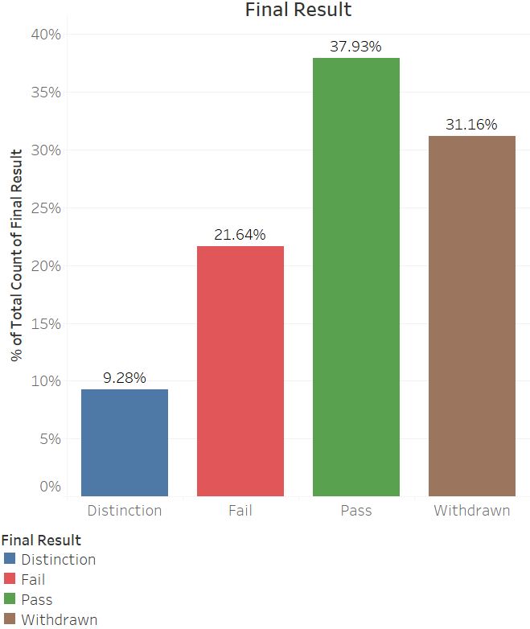
Situation Analysis
The current situation of the university highlights that
More than 30% of the students have dropped the course.
Around 20% students, faced difficulty and failed the course.
By reducing the drop-out and failure rate, the university can improve both revenue and student satisfaction.

Slide 4
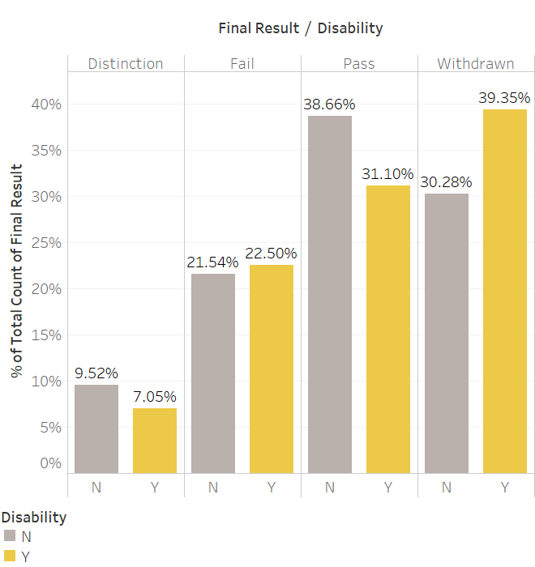
Dimensions contributing to high Failure or Withdrawal rate
DISABILITY
Around 40% of the students with disability have dropped the course

Slide 5
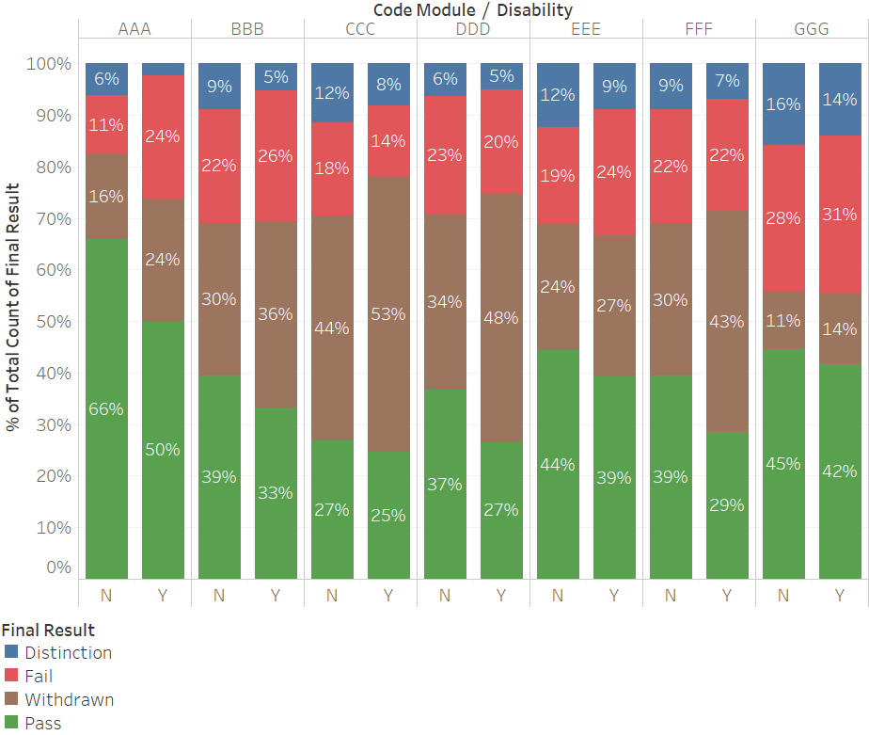
Dimensions contributing to high Failure or Withdrawal rate
DISABILITY
Around 40% of the students with disability have dropped the course.
The students with disability have ~10% higher rate of withdrawal in courses CCC, DDD and FFF

Slide 6
Dimensions contributing to high Failure or Withdrawal rate
DISABILITY
Around 40% of the students with disability have dropped the course.
The students with disability have ~10% higher rate of withdrawal in courses CCC, DDD and FFF
The high withdrawal rate suggests that these courses demand certain features in which students with disability face problems.

Slide 7
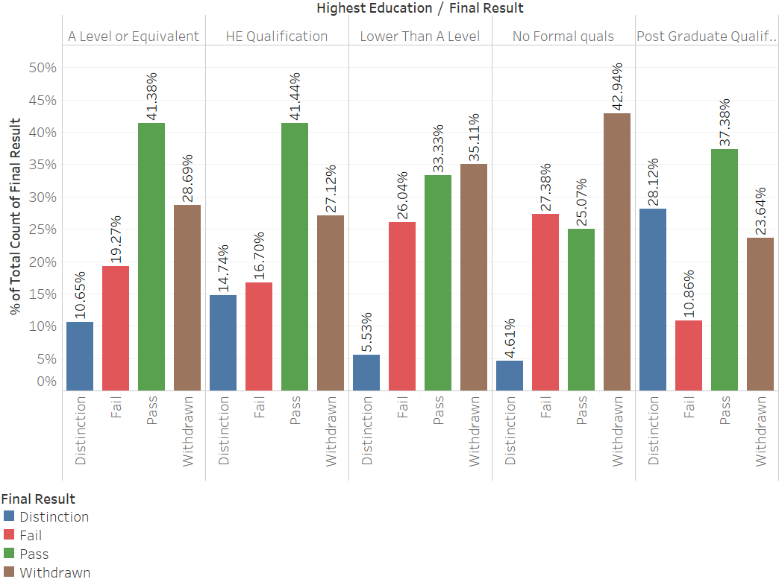
Dimensions contributing to high Failure or Withdrawal rate
EDUCATION LEVEL
Students with ‘No Formal Qualification’ have the highest Failure and Withdrawal rate

Slide 8
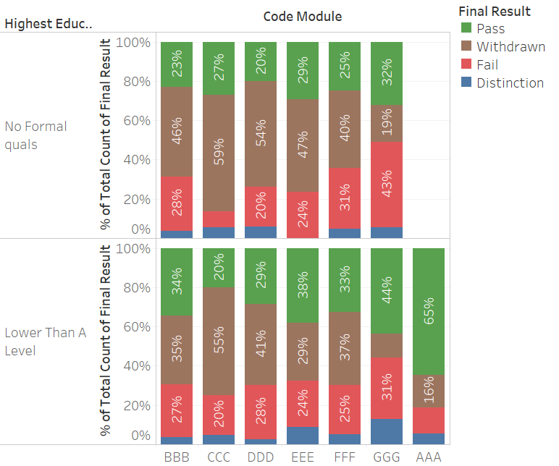
Dimensions contributing to high Failure or Withdrawal rate
EDUCATION LEVEL
Students with ‘No Formal Qualification’ have the highest Failure and Withdrawal rate
Students with No Formal Education
~70% rate of Failure or Withdrawal in courses BBB, CCC, DDD, EEE and FFF
Students with Lower than A Level Education
>60% rate of Failure or Withdrawal from courses BBB, CCC, DDD and FFF

Slide 9
Dimensions contributing to high Failure or Withdrawal rate
EDUCATION LEVEL
Students with ‘No Formal Qualification’ have the highest Failure and Withdrawal rate
Students with No Formal Education
~70% rate of Failure or Withdrawal in courses BBB, CCC, DDD, EEE and FFF
Students with Lower than A Level Education
>60% rate of Failure or Withdrawal from courses BBB, CCC, DDD and FFF
Data suggests that students with less education face difficulty in completing the courses as a result they are more likely to fail or drop courses.

Slide 10
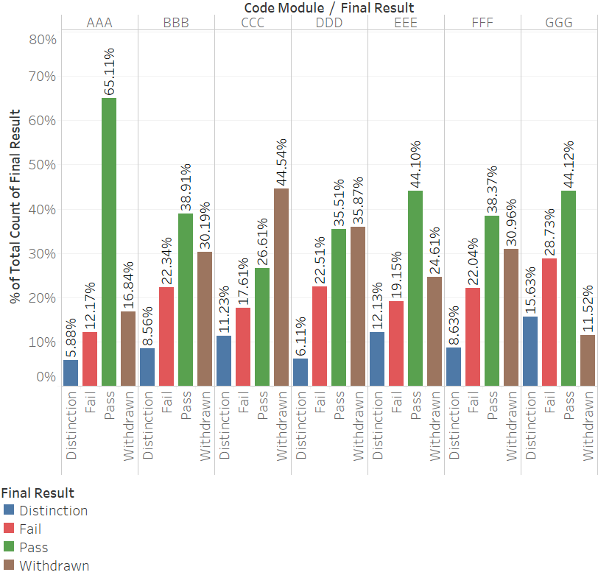
Dimensions contributing to high Failure or Withdrawal rate
COURSE MODULE
Majority of students who take module CCC or DDD, drop the course.
These two are the only courses where the pass rate is less than the withdrawal rate.

Slide 11
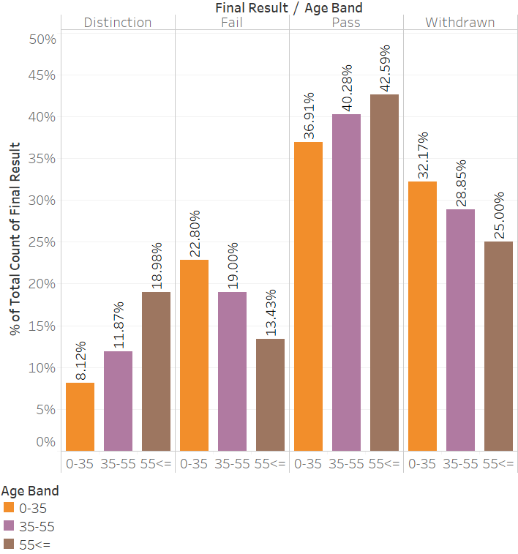
Dimensions contributing to high Failure or Withdrawal rate
AGE
It seems that there exists a trend in performance with respect to age.
Young individuals are at a higher stake of failing and withdrawing.

Slide 12
How to solve the problem of high failure and withdrawal rate?

Slide 13
Recommendations based on the Insights from Data

Slide 14



Recommendations
Offer Introductory Courses
Arrangement for students with Disability
Performance tracker for students

Slide 15
Recommendations
Offer Introductory Courses
As evident from the exploratory analysis, less educated students are struggling with certain courses like BBB, CCC and DDD.
Before enrolling less educated students in these courses, university should offer them introductory level courses
Arrangement for students with Disability
Performance tracker for students

Slide 16
Recommendations
Offer Introductory Courses
Arrangement for students with Disability
The high withdrawal rate among the disabled students in courses CCC, DDD and FFF, suggests that these courses demand certain features in which students with disability face problems.
The university needs to dig deep into these courses to find out the potential reasons of withdrawal, and make special arrangements for students with disability
Performance tracker for students

Slide 17
Recommendations
Offer Introductory Courses
Arrangement for students with Disability
Performance tracker for students
In order to decrease the Failure rate, university can provide performance tracker app to students.
By tracking their activity and engagement with the learning material in comparison to that of anonymized previous top-performing students, students will have a better picture of where they stand and how much do they need to improve.

Slide 18
Predictive Modeling A Preventive Measure Using ML to identify students who are at a higher stake of Failing or Withdrawing, so that university can take appropriate interventions in advance to solve the problem

Slide 19
Data
Age
Gender
Interaction
Number of clicks
Date Registered
Education Qualifications
Disability
Date Unregistered
Performance
Score
Result
Demographics

Slide 20
Data – Treatment/ Precautions
Target Variable
The variable Result has 4 categories - Pass, Fail, Distinction and Withdraw. Our goal is to predict whether a student will Pass, Fail or Withdraw, so we have combined Pass and Distinction as Pass.
Data Leakage
The following variables inherently contain the information that we want to predict
Date unregistered – if this variable has missing values that means student has not withdrawn from the course otherwise it will capture the number of days after the start of the module when the student has dropped from the course.
Score – this variable will tell us whether a student has failed, passed or has distinction.
Using the above variables in the model, will result in very high accuracy (~98%) but this model will not be of any use. As, for a student, we would not have the information when will he/she unregisters or how much did they scored in the assessment in advance.
Student Interaction
The variable sum_clicks captures the number of times a student has interacted with the module on a given day. A close look into this variable highlighted that there are multiple observations of click on a given day. We assumed that, data was captured at different time frames within a day. So, we have added all the sum_clicks for a given day for a specific student to capture the daily level activity.

Slide 21
The Model Models Implemented - Logistic Regression - KNN - Random Forest - XG Boost
Model Selected XG Boost (based on high accuracy and recall)
Performance
Test Accuracy: 71.7%
Recall: Pass = 0.93, Fail = 0.33 and Withdraw = 0.64
Important Features
Active_days, code_module, highest_education,
total_click, studied_credits and disability

Slide 22


Actions Based on the model, Open University can predict in advance whether a student is likely to Fail, Withdraw or Pass. University can take the following interventions based on the predictions
For a student predicted to
Fail
Withdraw

Slide 23
Actions Based on the model, Open University can predict in advance whether a student is likely to Fail, Withdraw or Pass. University can take the following interventions based on the predictions
For a student predicted to
Fail
1. The university can conduct virtual counselling session for the student to understand the areas where he/she is facing the problems.
2. Based on the problem area, university can provide assistance in terms of extra material, doubt session, feedback on past performance.
Withdraw

Slide 24
Actions Based on the model, Open University can predict in advance whether a student is likely to Fail, Withdraw or Pass. University can take the following interventions based on the predictions
For a student predicted to
Fail
Withdraw
1. The university can reach out to the student in advance, to understand the satisfaction level and expectations.
2. If the course is not a good fit, then the university can recommend other courses based on student’s interest, education qualification and career goals.

Slide 25
By executing the recommendations and implementing the appropriate interventions based on the results of the ML model, Open University can solve the issue of high failure and withdrawal rate.

Slide 26
Thank You!

